Slide 1
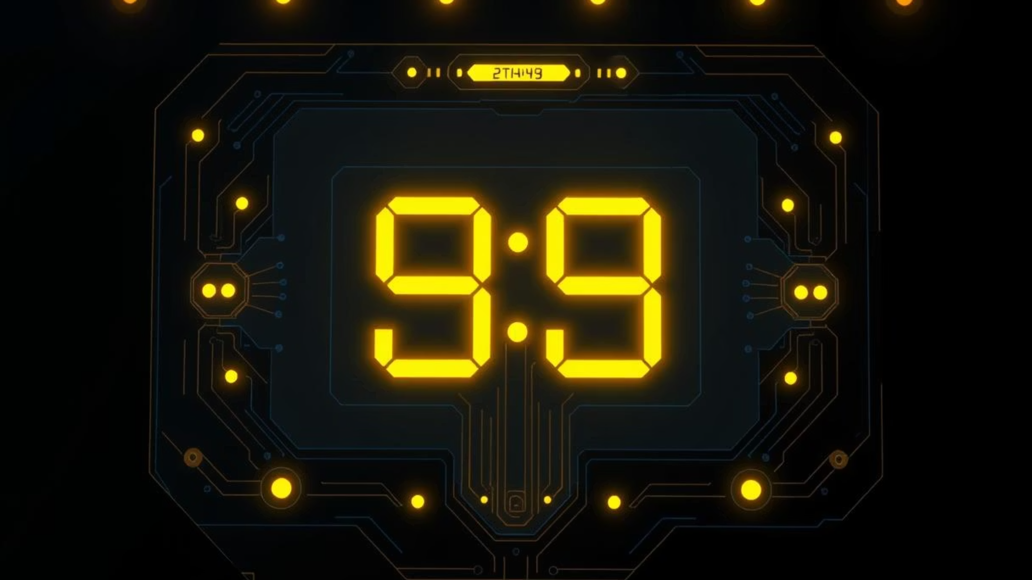
Advanced Real-Time Clock System
Using ATmega32 for Precision Timekeeping
Presented by Eng. Gasser & Eng. Ahmed

Slide 2




System Overview & Key Features
Our Advanced Real-Time Clock (RTC) system leverages the robust ATmega32 microcontroller and the highly accurate DS3231 RTC chip to deliver precise timekeeping and versatile timing functionalities. Designed for reliability and ease of use, it integrates seamlessly into various applications.
Core Microcontroller
High-Accuracy RTC
ATmega32 8-bit MCU running at 16 MHz, providing ample processing power for all timing modes.
DS3231 module with temperature compensation ensures highly precise timekeeping, critical for reliable operations.
Versatile Modes
Power Backup
Features a Real-Time Clock, flexible Alarm functions, a precise Stopwatch, and a user-friendly Countdown Timer.
Battery-backed RTC ensures continuous time retention, even during unexpected power interruptions.

Slide 3
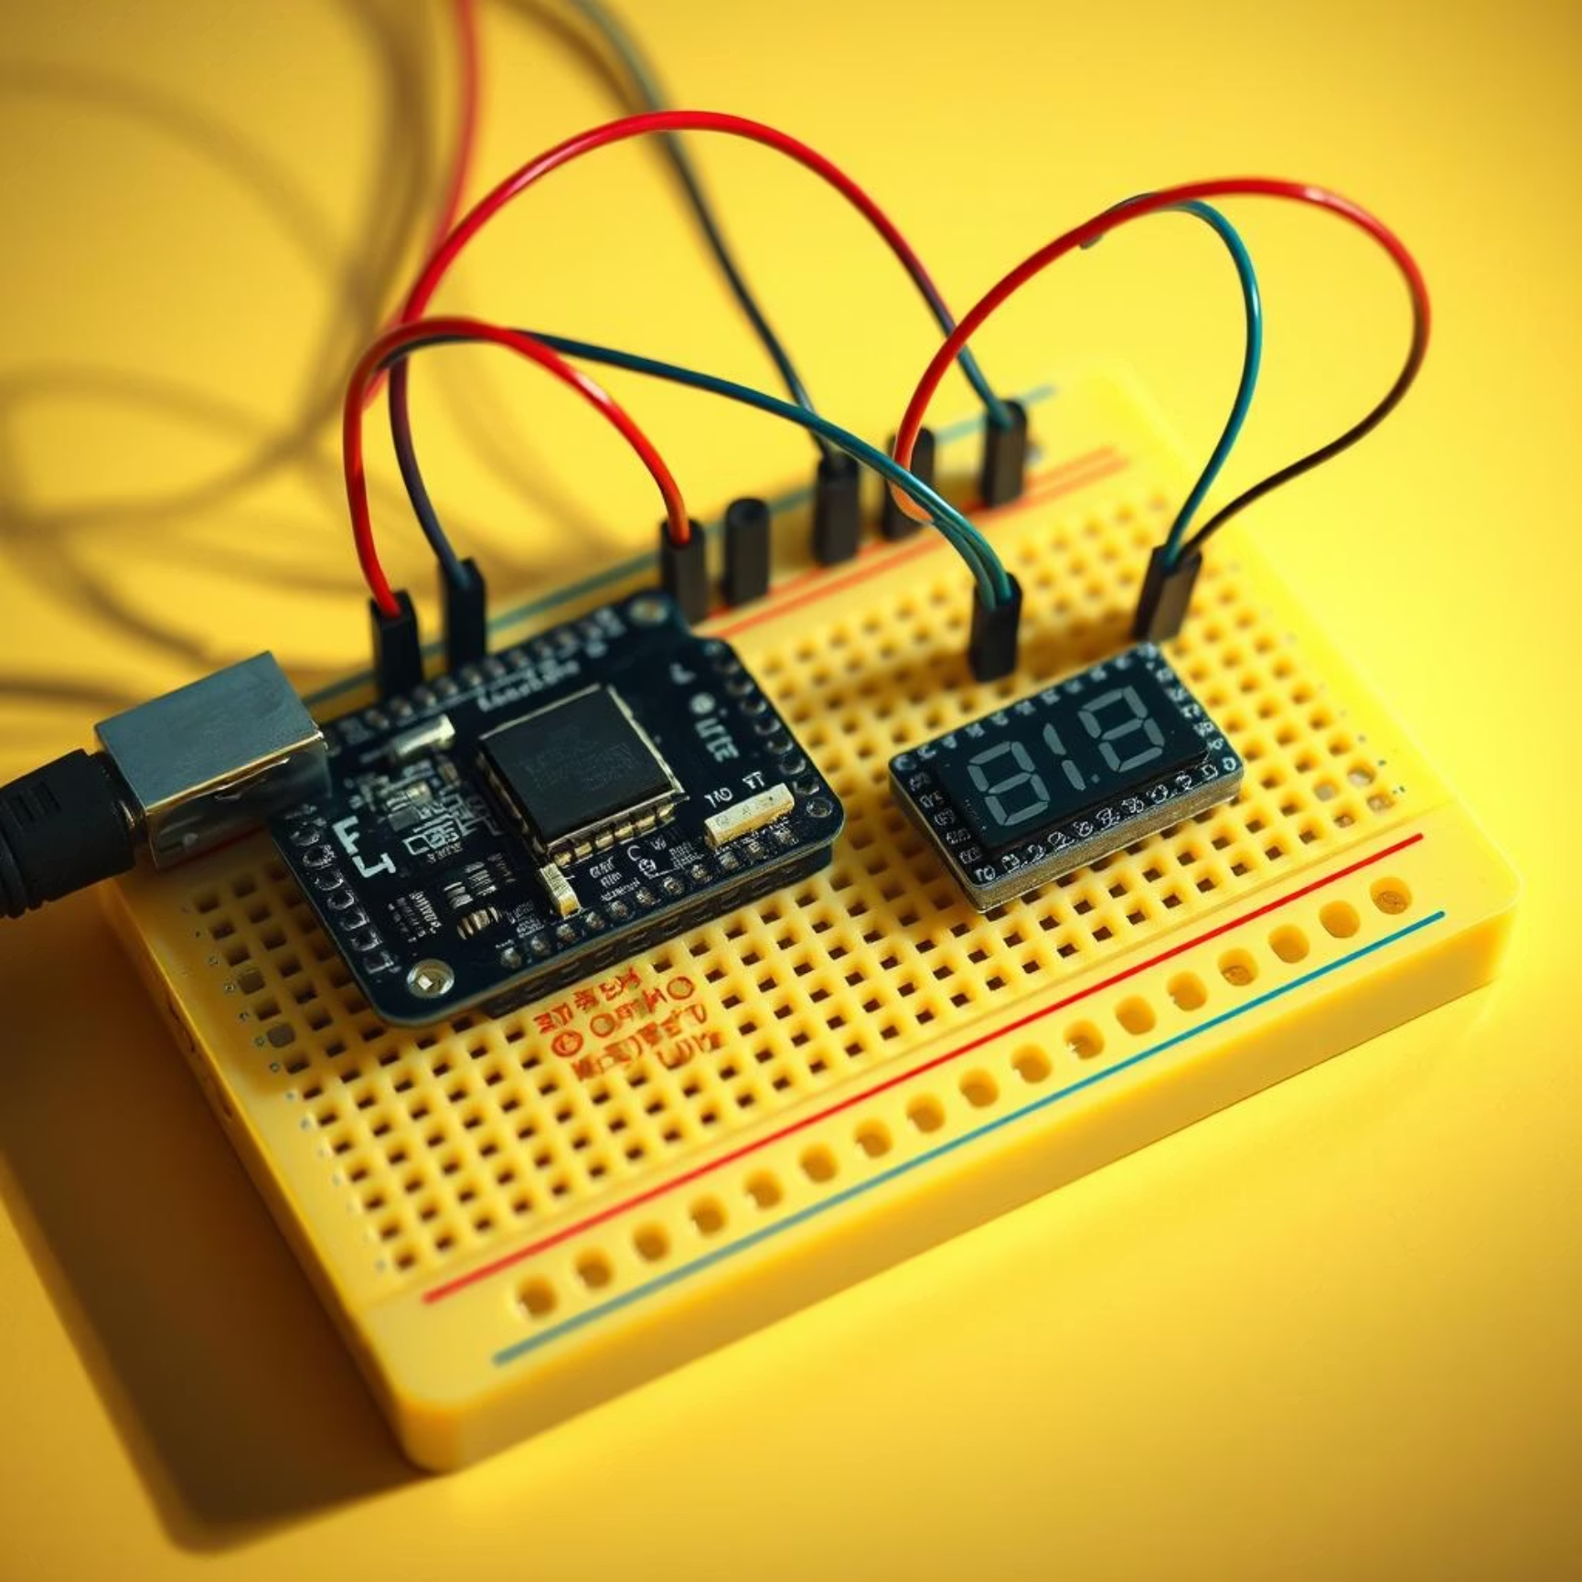
Hardware Components
The system is built upon a foundation of carefully selected components, ensuring optimal performance and reliability for diverse timing applications.
ATmega32 Microcontroller: 32KB Flash, 2KB SRAM, 1KB EEPROM for robust program and data storage.
DS3231 RTC Module: Features a built-in temperature-compensated crystal oscillator for superior accuracy.
16 MHz Crystal Oscillator: Provides the precise clock source for the MCU, critical for accurate timing.
Display Unit: Supports either a 128x64 GLCD (KS0108 controller) for detailed visuals or a 16x2 LCD for simpler displays.
Supporting components include standard resistors (10k, 4.7k), capacitors (22pF, 100nF), and a potentiometer for display contrast adjustment. A 5V regulated power supply is essential, complemented by a dedicated battery backup for the RTC module.

Slide 4
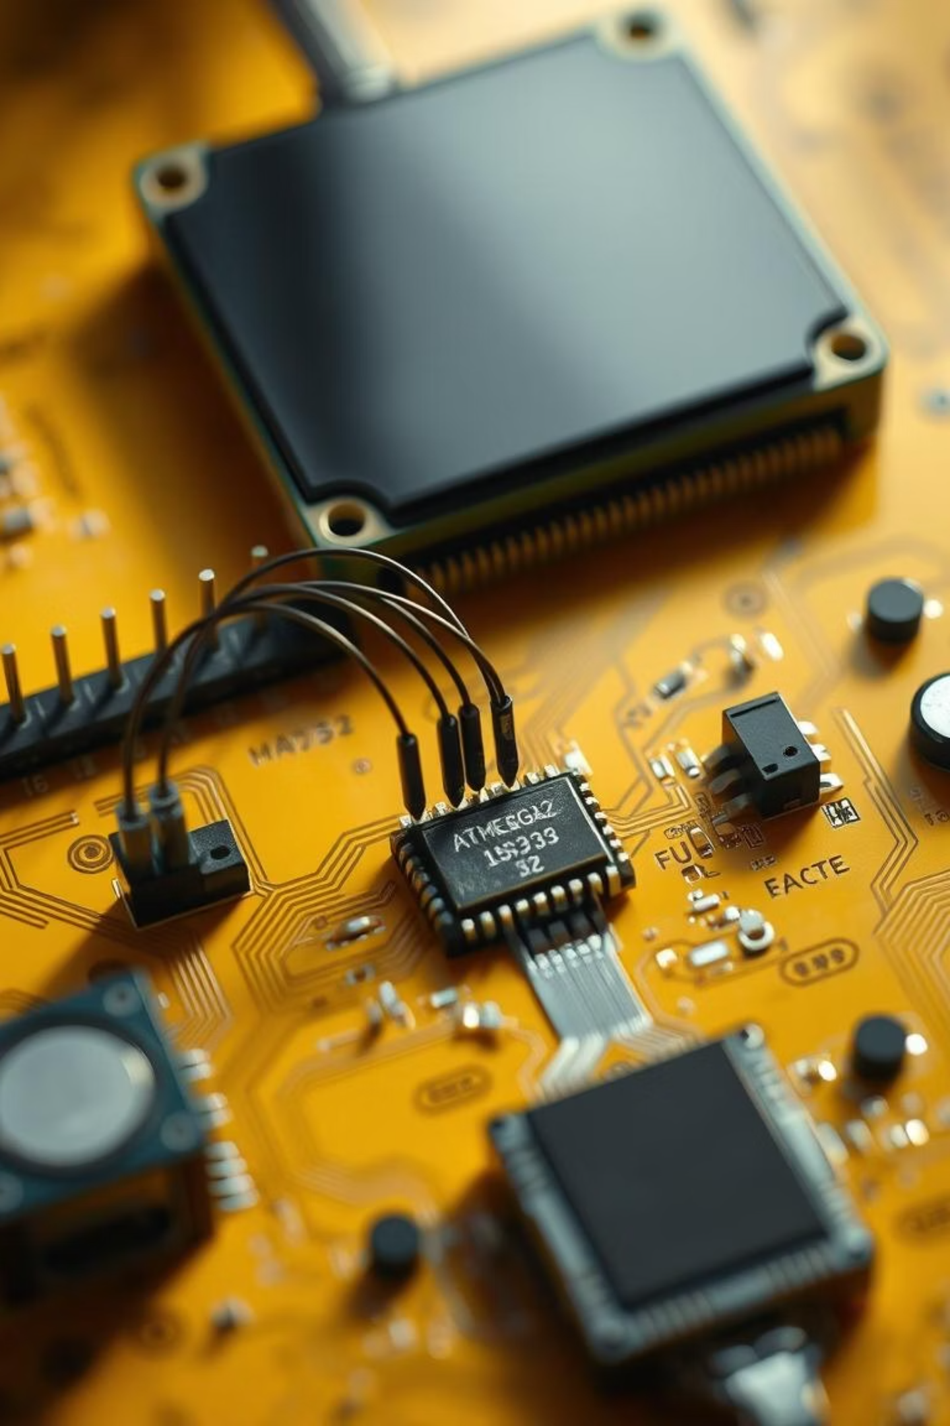
Pin Connections & Interface
Precise pin connections are paramount for the system's functionality, ensuring seamless communication between the ATmega32 and its peripherals.
DS3231 via I2C: SDA connects to PC1 and SCL to PC0, enabling efficient two-wire communication.
Crystal Oscillator: Connected to XTAL1 and XTAL2 pins of ATmega32 for stable MCU clocking.
GLCD Interface: Utilises PORTC and PORTD for data and control signals, providing a clear visual output.
Alarm Output: The DS3231's alarm pin is linked to an MCU interrupt pin (e.g., PD2 INT0) for immediate alarm detection.
Essential Reset, VCC, and GND pins are connected as per datasheet specifications to ensure system stability.

Slide 5
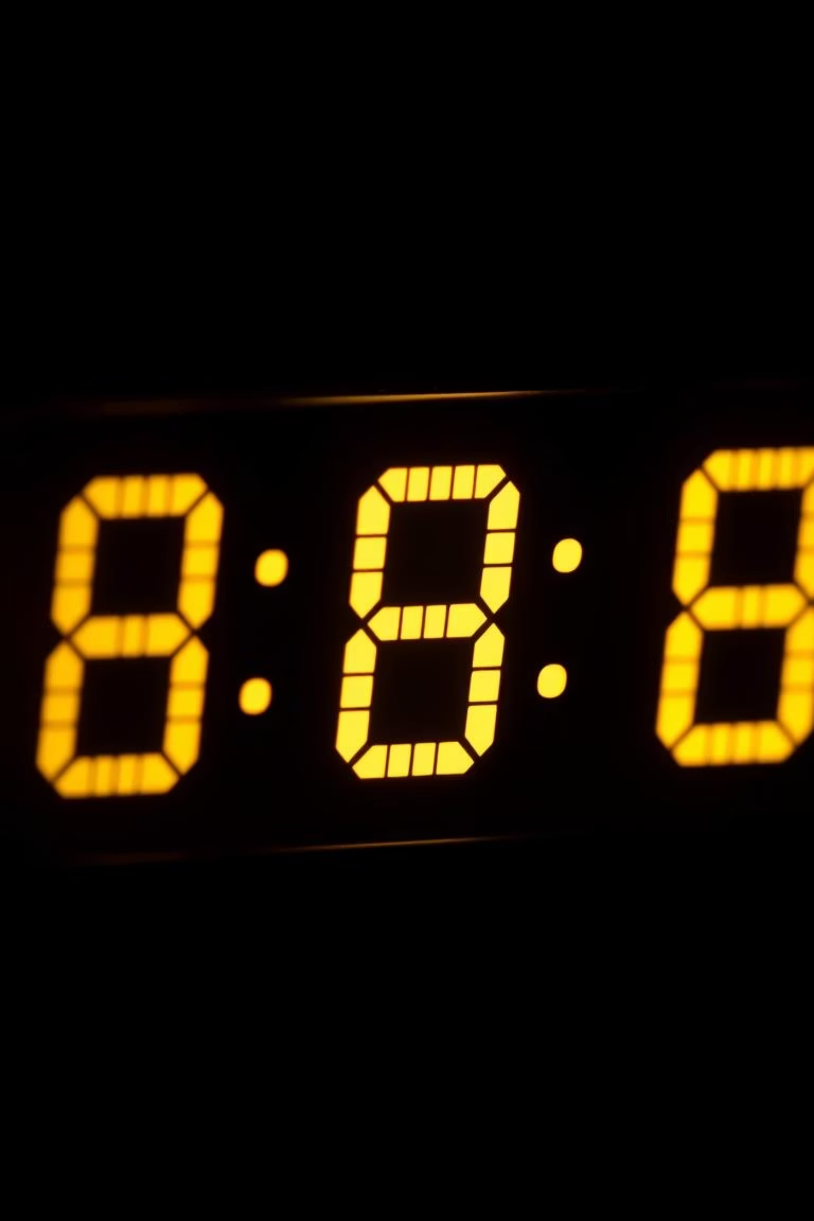
Real-Time Clock Mode
The core of our system, the Real-Time Clock (RTC) mode, provides highly accurate timekeeping for various applications. It continuously tracks the time and date, ensuring precise synchronization.
Comprehensive Timekeeping
Tracks seconds, minutes, hours, day of the week, date, month, and year with built-in leap year compensation.
Unrivalled Accuracy
Utilises the DS3231’s internal temperature-compensated crystal for an impressive ±2ppm accuracy, minimising drift.
Seamless Display Updates
The ATmega32 synchronises time on startup and updates the GLCD/LCD display every second for real-time visualisation.
Efficient Synchronisation
An interrupt-driven 1Hz SQW signal from the DS3231 keeps the MCU timer in perfect sync, avoiding constant polling and reducing CPU load.

Slide 6



Alarm Functionality
The integrated alarm feature offers versatile notification capabilities, making the system ideal for scheduling and event management. Users can easily program and manage multiple alarms.
Programmable Alarms
Instant Notifications
Alarm times are easily set and stored within the DS3231 registers, retaining settings even after power cycles.
Upon trigger, the alarm initiates an MCU interrupt, activating user-defined alerts such as a buzzer, LED, or a prominent display alert.
Flexible Scheduling
User Control
Supports both single-instance alarms and repeating alarms for daily or weekly events, catering to diverse scheduling needs.
The ATmega32 efficiently handles alarm acknowledgement and resetting, providing full control to the user.

Slide 7
Stopwatch & Countdown Timer Modes
Beyond basic timekeeping, our system incorporates two essential timing utilities: a high-precision stopwatch and a flexible countdown timer, enhancing its utility for a wide range of tasks.
Stopwatch Functionality
Countdown Timer
Utilises the ATmega32's internal timer/counter for accurate measurement of elapsed time.
Allows users to set a specific target time for countdown, perfect for cooking or productivity.
Features intuitive start, stop, and reset controls for precise timing operations.
The MCU intelligently manages the countdown process using its internal timers.
Ideal for sports timing, experiments, or any activity requiring precise elapsed time measurement.
Real-time display updates show remaining time in minutes, seconds, and even milliseconds for critical applications.
Mode switching between RTC, Alarm, Stopwatch, and Countdown Timer is seamlessly managed via dedicated buttons or a user-friendly menu interface, ensuring smooth operation.

Slide 8
Technical Specifications Summary
A concise overview of the key technical specifications that define the robust performance and capabilities of our Advanced Real-Time Clock System.
MCU
ATmega32, 16 MHz, 32KB Flash, 2KB SRAM, 1KB EEPROM
RTC
DS3231, ±2ppm accuracy, battery backup for 3-5 years
Power Consumption
Supports low power modes for extended battery life in both MCU and RTC
Communication
I2C bus for RTC, GPIO for display and controls, ensuring efficient data exchange
Operating Voltage
5V regulated supply, critical for stable operation of all components
Display
128x64 GLCD or 16x2 LCD with fine-tuned contrast adjustment for readability
These specifications highlight the system's robust design and its suitability for applications demanding high precision and reliability.

Slide 9
Troubleshooting Tips & Best Practices
Ensuring reliable operation requires careful attention to detail during assembly and deployment. Here are essential tips to prevent common issues and maximise performance.
I2C Pull-Up Resistors
Authentic DS3231 Modules
Crystal Oscillator Stability
Always ensure proper 4.7kΩ pull-up resistors on SDA and SCL lines for reliable I2C communication. This is crucial for data integrity.
Use only original or high-quality DS3231 modules to avoid timing drift issues often seen in cheaper clones, ensuring long-term accuracy.
Verify crystal oscillator connections and stability for optimal MCU clock accuracy, which directly impacts all timing functions.
Software Debouncing
RTC Battery Check
Implement software debouncing for all buttons to prevent false mode switching or erratic input, improving user experience.
Regularly check the battery voltage on the RTC backup to prevent time loss during power outages, ensuring continuous operation.

Slide 10

Conclusion & Next Steps
This ATmega32-based RTC system combines precision timekeeping with versatile timing functions, offering a robust and reliable solution for numerous applications.
Modular design allows easy expansion or integration with other embedded systems.
Practical for diverse applications in data logging, alarms, event timing, and user interfaces.
Thank you for your attention!
Questions?
Presented by Eng. Gasser & Eng. Ahmed

